Slide 2
DevOps: Azure Resource Manager y Powershell DSC
Ibon Landa
ALM & Cloud Team Lead
ilanda@plainconcepts.com

Slide 3

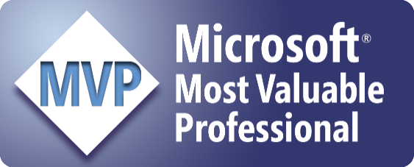

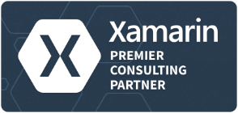

Ibon Landa
Associate at Plain Concepts
ilanda@plainconcepts.com
@ibonilm
http://geeks.ms/blogs/ilanda

Slide 5


Slide 6
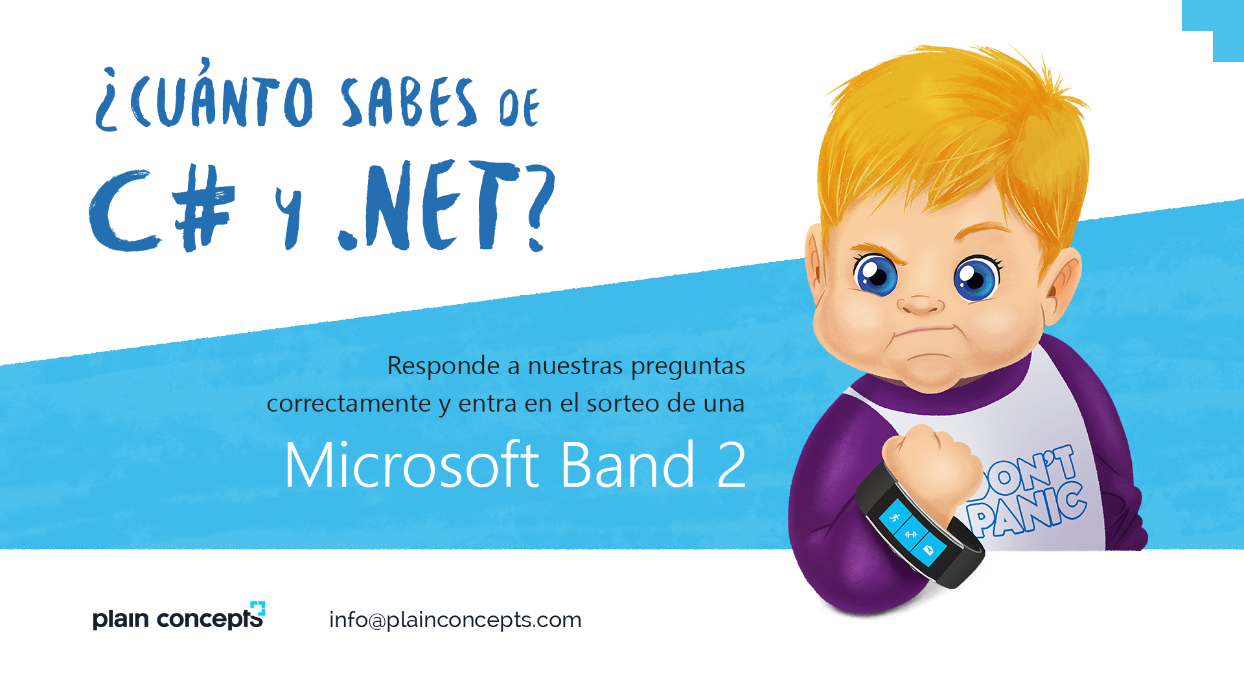

Slide 8

“DevOps is development and operations collaboration”
“DevOps is treating your infrastructure as code”
It’s DevOps!
It’s DevOps!
“DevOps is using automation”
It’s DevOps!
“DevOps is feature switches”
It’s DevOps!
“Scrum for Ops?”
“DevOps is small deployments”

Slide 9
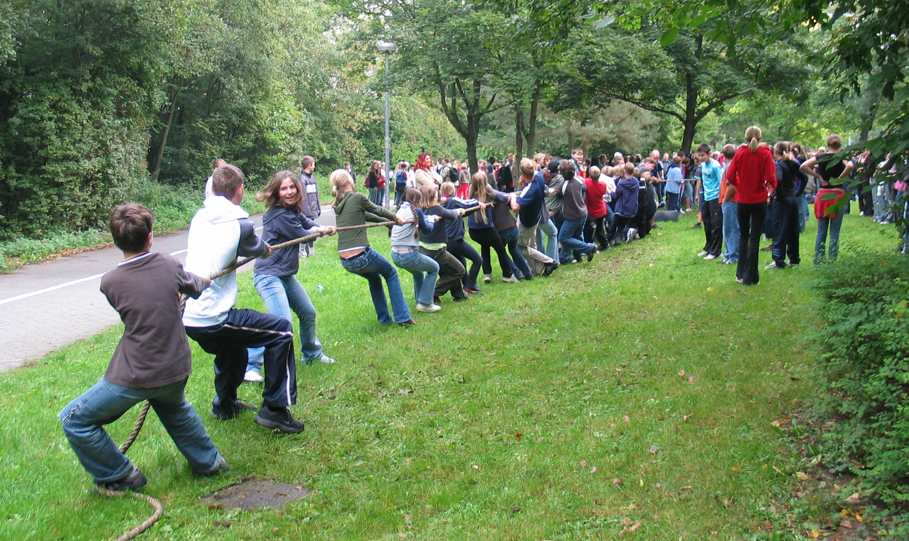
Practice DevOps!

Slide 10
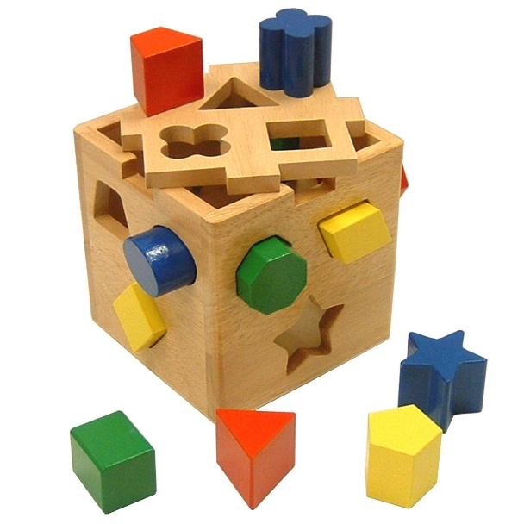
Continuous integration and delivery
Version everything
Automate everything
Tokenize configurations
Use one-click deployments
Deploy the same way to every environment
Have always a rollback mechanism in place
Build only once
Lock down the environments

Slide 11
Infrastructure as Code

Slide 12

Infrastructure as code
Infrastructure
IT infrastructure consists of all components that somehow play a role in overall IT and IT-enabled operations.
It can be used for internal business operations or developing customer IT or business solutions.
Code
A set of instructions or statements that are processed by a computer.
Infrastructure as code
Treating your infrastructure as code to ensure that is as versionable, repeatable, and testable as application code

Slide 13

Infrastructure as code – What it isn't
Not just … Writing Scripts
Not just … Infrastructure Automation
Not just … for the cloud
Not just … for non-production environments
Not … Devops
Not … Completely painless
Notes:
Infrastructure as code is not simply writing scripts, but involves using tested and proven software development practices that are already being used in application development.`
Not infrastructure automation, which just involves replicating steps multiple times and reproducing them on several servers.
Infrastructure as Code doesn’t only apply to cloud and virtualized infrastructures, it can also be used with “bare metal” infrastructure.

Slide 14


Infrastructure as Code
Habits
Production first mindset
Infrastructure as flexible resource
DEV
CODE
STAGE
Value
Optimized Resources
Accelerate Delivery
OPS
PRODUCTION
Measure
Deployment Rate
MTTR
DEV
OPS

Slide 15
Azure Resource Manager

Slide 16
Today’s Challenge
It’s difficult to…
→ Deploy or update a group of resources, repeatedly
→ Manage permissions on a group of resources
→ Visualize a group of resources in a logical view, including monitoring/billing

Slide 17
Introducing Resource Manager
Application Lifecycle Container
Declarative solution for Deployment and Configuration
Consistent Management Layer

Slide 18
Resource Groups
→ Tightly coupled containers of multiple resources of similar or different types
→ Every resource *must* exist in one and only one resource group
→ Resource groups can span regions
RESOU
R
CE G
R
OUP

Slide 19
Coupling for Resources
Resource Group is a unit of management
Lifecycle: deployment, update, delete, status
→ Grouping: metering, billing, quota: applied & rolled up to group

Slide 20
Resource Group Lifecycle
Question:
Should these resources be in the same group or a different one?
Hint:
Do they have common lifecycle and management?
Answer:
Up to you.

Slide 21
DEMO

Slide 22
Power of Repeatability
SQL-A
Instantiation of repeatable config.
Configuration → Resource Group
Website
Azure Templates can:
Ensure Idempotency
Simplify Orchestration
Provide Cross-Resource Configuration and Update Support
Azure Templates are:
Source file, checked-in
Specifies resources and dependencies (VMs, WebSites, DBs) and connections (config, LB sets)
Parametized input/output
[SQL CONFIG] VM (2x)
DEPENDS ON SQL
DEPENDS ON SQL
SQL - A
Website
Virtual
Machines
SQL
C
ONFIG

Slide 23
Deploying with Azure Resource Manager
Template-driven
Declarative
Idempotent
Multi-service
Multi-region
Extensible

Slide 24
Add your own Power
Some resources can be extended allowing more code or data inside the resource
AV agent inside a VM
WordPress Web-deploy package on a Website
Allow for Scripting or Imperative configuration of resources
Extensible solution (Windows and Linux):
VMM Agent
DSC (in-VM PowerShell)
Chef
Puppet

Slide 25
DEMO

Slide 26
Organizing with Azure Resource Manager

Slide 27
App-centric Resource Groups and Templates
Resource Group
My
3 Tier
Template
App
Service
Virtual
SQL DB
Machine
reference()

Slide 28
App-centric Resource Groups and Tier-centric Templates
Resource Group
My
DB Tier
Template
My
Web Tier
Template
My
VM Tier
Template
App
Service
Virtual
SQL DB
Machine
reference()

Slide 29
App-centric Resource Groups and Nested Templates
Resource Group
Parent Template
My Nested
DB Tier
Template
My Nested
Web Tier
Template
My Nested
VM Tier
Template
App
Service
Virtual
SQL DB
Machine
reference()

Slide 30
Tier-centric Resource Groups and Templates
Resource Group
Resource Group
Resource Group
My
DB Tier
Template
My
Web Tier
Template
My
VM Tier
Template
App
Service
Virtual
SQL DB
Machine
Linked Resource

Slide 31
Resource Tags
15
x
Name-value pairs assigned to resources or resource groups
Subscription-wide taxonomy
Each resource can have up to 15 tags

Slide 32
Tagging Tips
15
x
Tag by environment, e.g. dev/test/prod
Tag by role, e.g. web/cache/db
Tag by department, e.g. finance/retail/legal
Tag by responsible party, e.g. Bob

Slide 33
Introducing Azure Dev/Test Lab

Slide 34
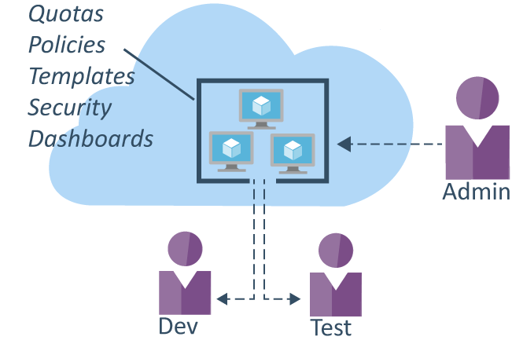
Azure DevTest Labs (Preview)
Fast, easy, and lean Dev/Test environments
Quickly provision development and test environments
Create a VM in a few clicks with reusable templates
Quotas and policies
Automated shutdowns
Build Windows and Linux environments

Slide 35
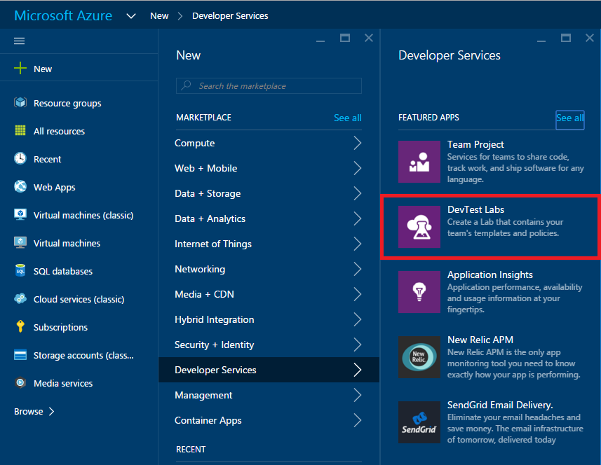
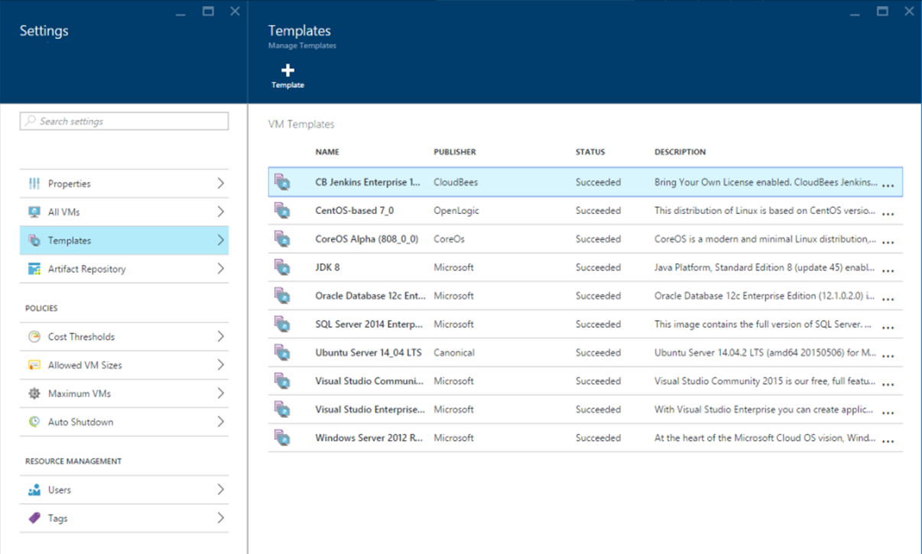

Slide 36
DEMO

Slide 37
PowerShell Desired State Configuration

Slide 38
PowerShell Desire State Configuration (DSC)
Configuration-management platform
Tool-agnostic
Standards-based
Distributed

Slide 39
PowerShell Desire State Configuration (DSC)
Enables you to ensure that the components of your data center have the correct configuration
Supports continuous deployment
Prevents configuration drift
Enable declarative, autonomous and idempotent (repeatable) deployment, configuration and conformance of standards-based managed elements

Slide 40
Scenario overview
Test Environment
Production Environment
Test Environment
Data
Prod Environment
Data
Hyper-V VM
Azure VM
ASP:NET MVC
Pre-Reqs (IIS, .Net, ...)
Code
Accounts
Plugins
Dev Code – Feature
Blank VM
ASP.NET MVC
Pre-Reqs (IIS, .Net, ...)
Code
Accounts
Plugins
DSC Configuration
New feature
Theme
SQL Azure
App
Accounts
Permissions
Test Data
SQL Azure
App
Accounts
Permissions
Production Data
Execute Tests

Slide 41
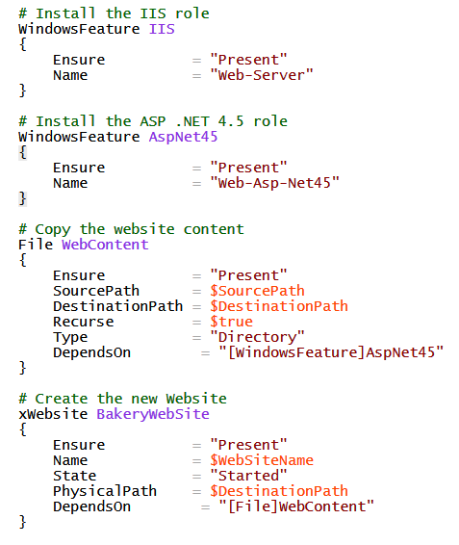
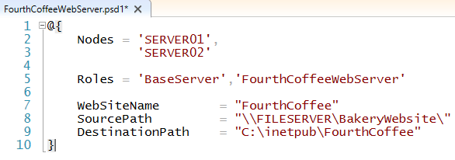
Configuration
Notes:
True configuration management allows infrastructure configuration to be treated like source code where changes are tracked over time.
The configuration documents in DSC describe the “intent” or “this is what the server should look like.”
Structural are the aspects that remain constant throughout environments.
Environmental are the aspects that change depending on the environment.
Human readable configuration serves double-duty as documentation.
It’s no longer necessary to have written instructions and screenshots when the configuration itself specifies the “desired state.”

Slide 42
PowerShell Desired State Configuration
Simplicity
Velocity
Flexibility
Declarative management
Resource reusability
Push/Pull deployments
Engine settings
Automation releases
Integrated Azure Extension
Configuration data

Slide 43
Domain Join
Node localhost
{
WindowsFeature ADPowershell
{
Name = "RSAT-AD-PowerShell"
Ensure = "Present"
}
xWaitForADDomain WaitForDomain
{
DomainName = $DomainName
DomainUserCredential= $Admincreds
RetryCount = $RetryCount
RetryIntervalSec = $RetryIntervalSec
DependsOn = "[WindowsFeature]ADPowershell"
}
xComputer DomainJoin
{
Name = $MachineName
DomainName = $DomainName
Credential = $DomainCreds
DependsOn = "[xWaitForADDomain]WaitForDomain"
}
}

Slide 44
Integrated Azure Extension
"type": "Microsoft.Compute/virtualMachines/extensions",
"name": "[concat(variables('vmName'),'/domainjoin')]",
"properties": {
"publisher": "Microsoft.Powershell",
"type": "DSC",
"typeHandlerVersion": "2.8",
"settings": {
"ModulesUrl": "[concat(parameters('assetLocation'),'Configuration.zip')]",
"ConfigurationFunction": "Configuration.ps1\\DomainJoin",
"Properties": {
"DomainName": "[parameters('domainName')]",
"MachineName": "[parameters('vmName')]",
"AdminCreds": {
"UserName": "[parameters('domainAdminUsername')]",
"Password": "PrivateSettingsRef:domainAdminPassword"
}
}
},

Slide 45
DEMO

Slide 46
VSTS Integration

Slide 47




DevOps
1
4
Plan
Monitor + Learn
Development
Production
2
3
Develop + Test
Release
Notes:
Based on what we learned from our own experiences and what we see happening in the industry, a converged DevOps lifecycle gives you the ability to execute on ideas quickly and iterate on feedback rapidly, with minimum friction while at the same time maintaining the highest level of quality
DevOps practices emphasize systems thinking, breaking down of silos, collaboration and flow of value
This is not so much about tools, it is about people first, process second. Tools facilitate the necessary process and cultural changes

Slide 48
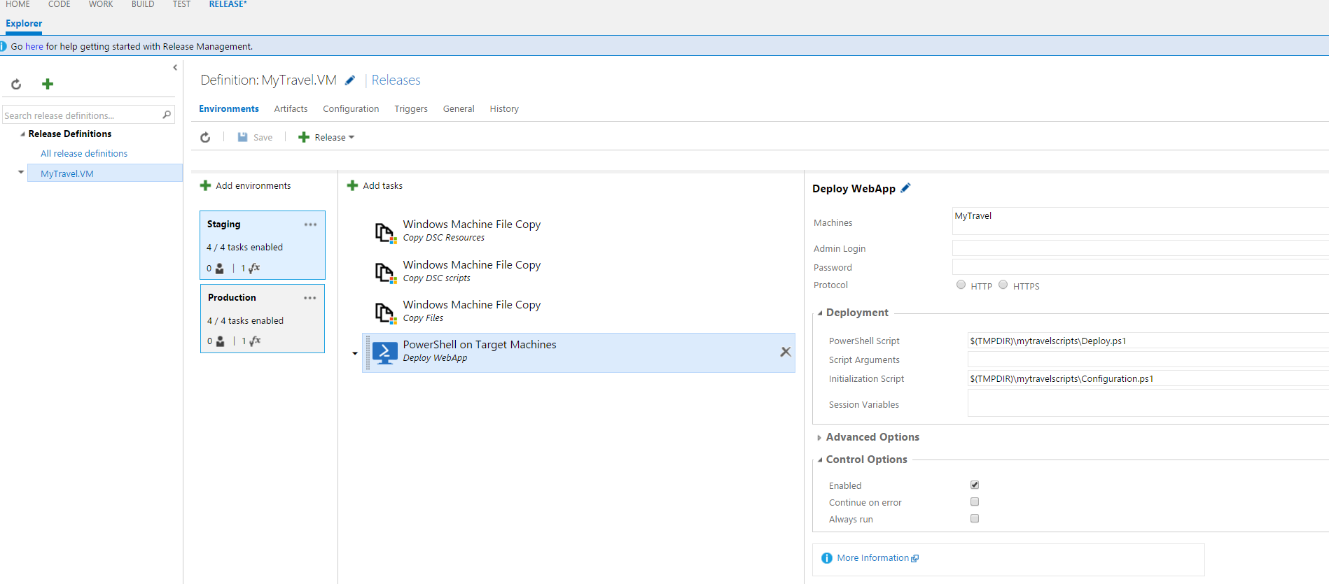
VSTS integration – Powershell DSC

Slide 49
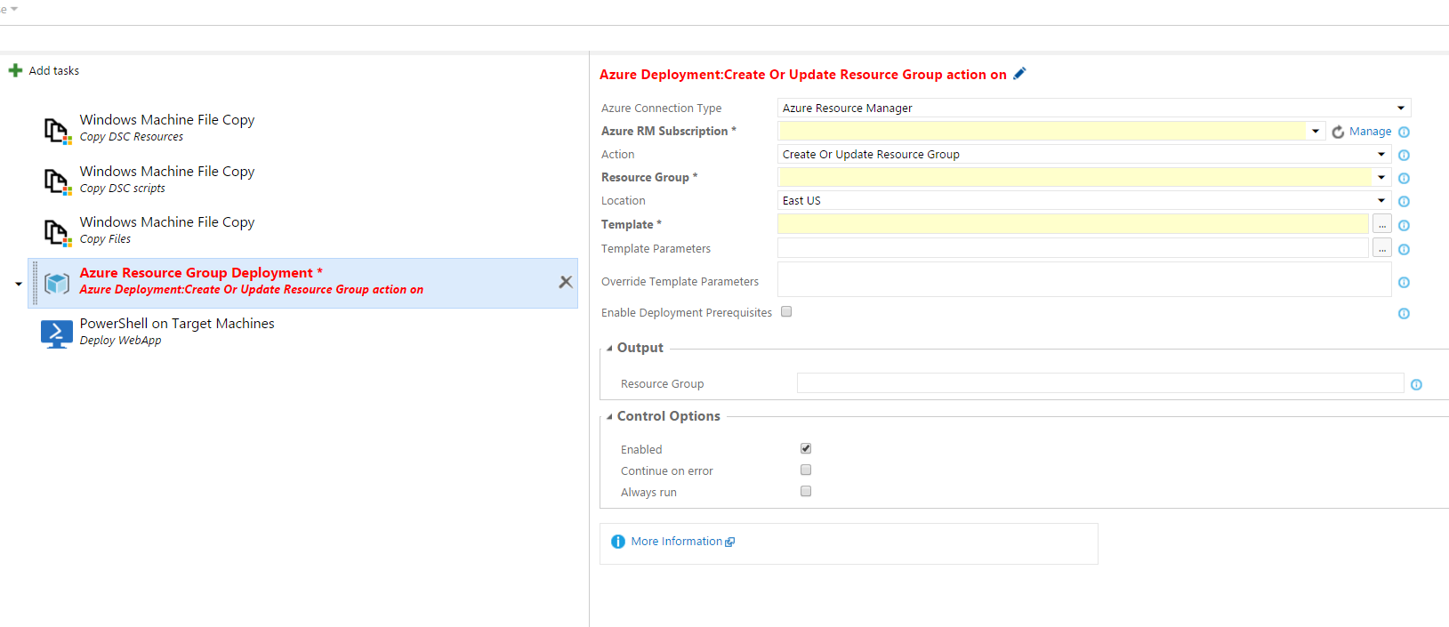
VSTS integration - Resource Manager

Slide 51

Ibon Landa
ALM & Cloud Team Lead
ilanda@plainconcepts.com
http://aka.ms/DOTNETT2S3

